Slide 1



SQS, SNS , SWF
Amazon AWS Distributed Computing Services
Notes:
----- Meeting Notes (9/7/14 17:11) -----
Speak to distrubuted nature interests.
Interest in data analysis, how that relates to distrubted computing
Need ways to track jobs, tasks, pick them up and complete them.

Slide 2
Distributed Computing
Architectural decision to distribute the workload amongst a cluster of machines.
Machines operate in a stateless manner.
Processes are independently managed, restarted, terminated and dealt with.
Ability to process load is based on demand.
System responds with more workers.

Slide 3
SQS Simple Queue Service
Reliable and scalable solution for hosting queues
Provides for storage of messages as they travel between computational nodes or humans
Why wouldn’t a worker just keep track of the messages?
Polling and pulling based service
What are the implications of polling and
pulling? It’s all about request$

Slide 4
SQS Service Features
Redundant infrastructure
Built for high scale concurrency
Messages can vary in size
Access control based on IAM/SQS policies
Provisions can be made for delay queues

Slide 5
SQS Redundancy
Guaranteed delivery of your queued messages at least once.
Each message is stored on multiple servers, transparently to the developer.
Although delivery is guaranteed, order is not – so beware and plan ahead!
Store sequencing information in message
Notes:
----- Meeting Notes (9/7/14 17:11) -----
Stored on multiple servers plays into the short and long polling
and how AWS needs to provide a 'fast' service based on their own distrubuted architecture.

Slide 6
SQS Service Features
Redundant infrastructure
Built for high scale concurrency
Messages can vary in size
Access control based on IAM/SQS policies
Provisions can be made for delay queues

Slide 7
SQS high scale concurrency
Multiple nodes or workers can access the same queue.
Messages are locked for a certain period of time.
Message locking can be changed on-the-fly.
Messages, while locked, are effectively hidden from view of other workers.

Slide 8
SQS Service Features
Redundant infrastructure
Built for high scale concurrency
Messages can vary in size
Access control based on IAM/SQS policies
Provisions can be made for delay queues

Slide 9
Message size
Messages can be, at most, 256K in size.
You can spread message packages across multiple messages.
Larger messages can also be stored in S3 and referenced by SQS messages.
Each 64K piece of a message is billed as 1 request: 256K == 4 requests.
We will cover requests in a little while.

Slide 10
Message Structure
Message ID : System-assigned GUID
Receipt handle :
Used to delete a message from a queue
Used to change message visibility
Visibility
Received messages are made invisible to other receivers until the visibility timeout expires
You will want to delete during invisibility window, else another worker could pick up the message.
You can also extend the invisibility window if you
recognize the processing time taking longer
than expected.

Slide 11
SQS Service Features
Redundant infrastructure
Built for high scale concurrency
Messages can vary in size
Access control based on IAM/SQS policies
Provisions can be made for delay queues

Slide 12
Access Control
SQS has its own resource based permission system through policies similar to IAM.
Difference from IAM: SQS policies allow for granting external AWS accounts permissions to queues.
IAM policies can also be used allowing SQS queue access.
IAM and SQS policies can work together.
As always, deny by default; deny trumps
allow.

Slide 13
Example IAM and SQS Policies
IAM Policy
SQS Policy
Allow
Actions:
ReceiveMessage
SendMessage
Resource:
arn:aws:sqs:*:123/queue_xyz
Allow:
Joe
Sue
Actions:
ReceiveMessage
SendMessage
Resource:
arn:aws:sqs:*:123/queue_xyz
Joe
Sue
queue_xyz

Slide 14
SQS Service Features
Redundant infrastructure
Built for high scale concurrency
Messages can vary in size
Access control based on IAM policies and roles
Provisions can be made for delay queues

Slide 15
Delay Queues
Delay queues force every message to be initially invisible to consumers for fixed period of time.
Useful when you want to allow up to 15 minutes to pass before a message is consumed.
Ecommerce use-case
Allow for cancelling of orders within 15 mins?
Your architecture might mix and match queues with delay queues.

Slide 16
SQS Requests
Requests can have up to 10 messages
Total size maxes at 256KB
Requests can be:
Queue management
Message management
Permission management
First million are free; after that ~$.50/1M

Slide 17
Polling implications and decisions
Short polling is default
Short polling means immediate response.
Poll request is made and SQS samples random SQS servers for messages (weighted distribution).
Empty message responses are possible, especially when queue population is less than 1K.
Subsequent requests will eventually get you the messages.

Slide 18
Polling implications and decisions
Long polling
Leverages services ability to respond when there is actually a message to return, as long as connection stays up.
Reduces the occurrence of empty responses.
Empty responses may be false, in the case of the short polling sampling.
How do we control the window of time to return a response when long polling?

Slide 19
Long Polling
Three ways to ‘Long Poll’ your queues
Queue Level (CreateQueue/SetQueueAttributes)
ReceiveMessageWaitTimeSeconds (>0 <= 20)
Message level (ReceiveMessage)
WaitTimeSeconds (> 0 <= 20)
ReceiveMessage level decisions trump Queue level configuration.

Slide 20
Long Polling Best Practice
Long polling multiple queues is best served when one thread/worker is dedicated to a single thread.
Allows consumption and computation of a message from one queue while other threads wait for other queues to return response.
If one thread monitored all queues, you would possibly be waiting a long time.

Slide 21
Dead Letter Queues
Allows for a queue to house messages that were not successfully processed.
Queues will send messages, automatically, after processing fails a configurable number of times.
Number of receives can range from 1-1000.
Configured per source queue to send to target dead message queue.
Allows for isolating problem messages.
Instead of checking 20 queues, one queue
could be checked.

Slide 22
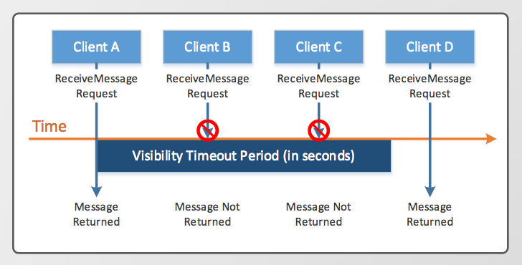
Message lifecycle

Slide 23
Pseudocode Interaction
client = getAmazonSQSClient(region)
client.createQueueRequest(“myQueue”)
client.sendMessage(new SendMsgReq())
mgs = client.receiveMessage(new ReceiveMsgReq())
for (Message msg: mesgs) {
/* process the message! */
}

Slide 24
Other notes of interest
Full CloudWatch integration
Monitor any number of metrics
Set thresholds for Queue performance
Set thresholds for Message receive/empty response performance
Receive emails when thresholds are exceeded.

Slide 25
What if Queues aren’t good enough?
Implications of SQS Queues
There is a guaranteed lag between a message being sent and picked up.
Depending on number of messages, configuration of queues and wait windows, lag could be substantial.
Time critical systems may need to alerted when there is a new message, rather than polling.
Does AWS have a solution? Of course!

Slide 26
SNS Simple Notification Service
Provides for coordinated and managed delivery of messages to clients.
Push service, instead of polling, based on who subscribed to which topic.
Multiple types of clients can subscribe to topics such as http, email, sms, SQS queues

Slide 27
SNS Terminology
Topic
Channel of communication
Defined per region
Referenced by ARN (Amazon Resource Name)
Subscribe
Link a topic to an end-point
Publish
Post message to a topic
All subscribers will receive it
Message content can be dependent on protocol of the subscribing end-points

Slide 28
SNS Usage Scenarios
Fan-out
Each message sent to a topic can be sent to multitude of different end-points allowing parallel, asynchronous processing.
Alerting
Leverage different topics for different alerts such as system or functional alerts and thresholds.
Plugs easily into Amazon services allowing for those services to alert engineers of issues.
Push notifications
Email, SMS, mobile push

Slide 29
What can Access Control, control?
Leverages the well-known IAM service
Configuration models:
Control the publishers by who and why/when
Control the subscribers and the way in which they are allowed to subscribe:
Email, HTTP, SNS, SMS etc..
Grant access to external accounts

Slide 30
Using SQS and SNS together
SQS – Stores messages for consumption.
SNS – Publishes messages for consumption.
What if we wanted to publish a message to a few queues, SMS, email and a web service?
Could send it to a few queues, push to a web service and use emails for the rest.
That could work, but it seems fragile.
We could use the intended publishing platform, SNS!
This was basically why SNS was created!

Slide 31
How would this work?
Policy would be written for the SNS topic to which we publish.
When message is published, the subscribing end-points will receive the message.
Most importantly, the SQS queue will receive the message and systems can then process it.
This allows for humans to react, if necessary, as well as automated systems to take over processing their responsibility.

Slide 32
Why use SQS and SNS?
SQS by itself
Polling is delay
Delay can be a few seconds, up to 30, depending on limitations of polling type, interval, message load etc..
SNS by itself
All the end-points are notified.
Workers can be notified to pick up a message
Reduces the delay significantly

Slide 33
SQS and SNS together, step-by-step
Create topic
Subscribe a SQS queue to the topic
Subscribe a worker process, over HTTP(S) to the topic (use an ELB just in case!)
Publish message
SNS pushes message to the queue
SNS notifies, over HTTP(S), to start processing the message.

Slide 34
IAM policy to allow SNS publication to SQS
{
“Version”:”2012-10-17”,
“Statement”:[{
“Sid”:”SNStoSQSPolicy”,
“Effect”:”Allow”,
“Prinicipal”:”*”,
“Action”:”sqs:SendMessage”,
“Resource”:”arn:aws:sqs:us-east-1:123456789:MyQ”,
“Condition”:{
“ArnEquals”:{
“aws:SourceArn”:”arn:aws:sns:us-east-1:123456789:MyTopic”
}
}
}]
}

Slide 35
Implications of SQS with SNS
Worker process notified and starts polling
In the event of failures, regular polling by a worker will pick it up eventually (with SNS, your queue polling can have longer intervals)
Combination of services provides:
Message reliability
Handle broken workers/processes
Closer to real-time processing

Slide 36
Publishing Pricing
Publish, topic owner, subscriber API calls
First million free
$.50/1M
Payloads
256KB max
64KB chunks billed as 1 request
API call, with 256KB of data, is 4 requests

Slide 37
Delivery Pricing (subscribed end-points)
Mobile Push: $.50/million
SMS: $.75/100
Email: $2/100k
HTTP(s): $.60/million
SQS: FREE! (billed on the SQS side)
Each 64KB is billed as one request

Slide 38
What if we need something a little bit more robust?
SQS and SNS are messaged based.
What if our tasks, spawned by messages, become increasingly difficult to manage?
Keeping track of messages in larger systems, when those messages take increasingly longer to consume, can be difficult.
What if there was a service whose API is built around task management, rather than message management?

Slide 39
SWF Simple WorkFlow Service
API allowing for easy coordination of work across components of your applications
Manages:
Execution dependencies
Scheduling
Concurrency
Abstracts the complexity of tracking progress of tasks and state of tasks
Aims to maximize utilization and throughputs, while minimizing latency

Slide 40
Why not go homegrown?
Distributed applications require attention to failed, long running tasks or need to restart them.
Must account for tasks being consumed once and only once.
Allows developers to focus on their application logic instead of the workflow of processing that logic and/or jobs.

Slide 41
SWF terminology
Workflow: A sequence of tasks called a workflow execution
Worker: Application component which completes tasks, and has a task order, can manage conditional flows and loops
Decider: Application component which coordinates tasks, such as order, concurrency and scheduling
Execution: A run of a worker
Actor: Workflow starter, decider, worker

Slide 42
SWF terminology cont..
Task: Code specifying what will be done
Activity task: Tell activity worker to do something
Decision task: Tell decider workflow state has changed; decide what to do next
Signal: Allows injection of information into running workflow execution
Alert a shipping process that a customer wanted three more Arduinos (Steven’s order)
Timer: Notify a decider that a certain amount of time has passed, allowing future decisions to be altered.
A customer might want to delay a shipment of items
Marker: Leverage SWF service to record information of the workflow history, such as progress of activity, or execution summary.

Slide 43
Developer APIs
Complete library of web service APIs
AWS Flow Framework
Enables development of Amazon-SWF applications quickly and easily
Calls SWF, tracks execution state, executions proper portions of code at the right times

Slide 44
Use cases
Video encoding
Chunk based encoding; reconstruction of complete video after all chunks are processed, asynchronously
Variable processing times
Migration of physical datacenter to the cloud
Workers consume jobs while rest of datacenter remains operational
More and more pieces of datacenter are migrated
Batch processing of heterogeneous jobs

Slide 45
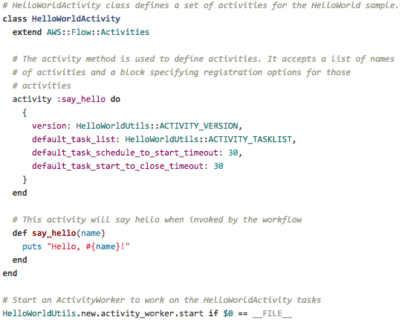

AWS Flow Framework Activity

Slide 46
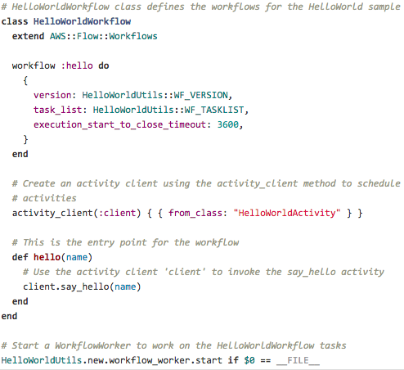

AWS Flow Framework Workflow

Slide 47


Execute an AWS Flow Framework
Implemented activity
Implemented workflow coordination
Implemented worker to run workflow and associated activities
What we did not have to write:
Anything to do with tracking or restarting
The rest of the services provided by AWS FF

Slide 48
Resources for Getting Started
http://aws.amazon.com/swf/
http://aws.amazon.com/swf/developer-resources/
Includes code and webinars

Slide 49
Pricing
Free
First 1,000 workflow executions
During execution
First 30,000 open and retained workflow days (24 hours)
After execution
First 30,000 open and retained workflow days (24 hours)
First 10,000 tasks, signals, timers, markers
$1/10,000 workflow executions
$.000005/24 hour period a workflow is open or closed
$.000025 per task, signal, timer, marker

Slide 50
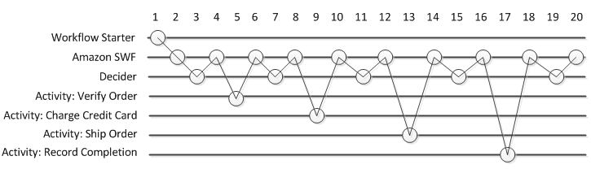
Visualization of SWF execution
Workflow starter calls SWF action to start execution of an order.
SWF receives request and schedules first decision task.
Decider receives task, ensures no previous activities occurred, makes decision to schedule Verify Order activity, returns decision back to SWF.
SWF receives decision, schedules Verify Order and waits for activity task to complete.
“Verify Order” capable activity worker receives task, performs it, and returns results back to SWF.
SWF receives outcome of SWF, time to call on a decider..

Slide 51
Distributed Computing with AWS
SQS
Poll based messaging system
Dependent on number of messages queued
Lag can be an issue
Managing tasks, completion, deletion on developer
SNS
Push based message system
Fan out capable to various endpoints
Interacts with SQS very easily
SWF
Framework for managing complex activities across your distributed system
Compartmentalizes activities and decisions to specific domain objects allowing for framework to manage and coordinate

Slide 52
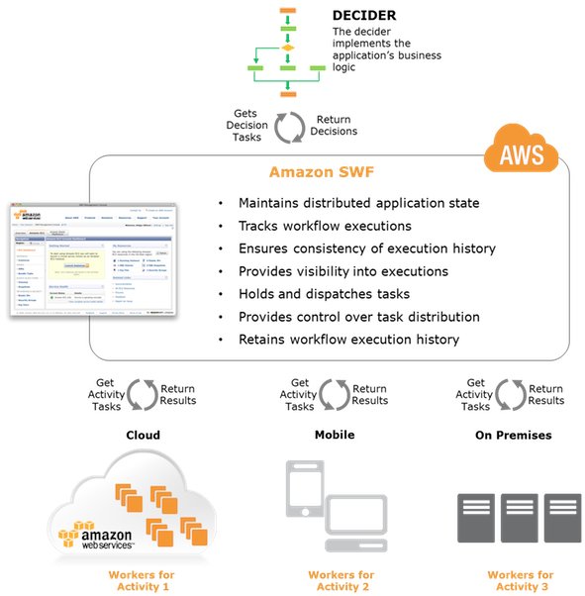
SWF simplified

